Slide 1









INNOVATION IN TRANSPORTATION
ROAD REVOLUTIONERIS
Team MEMBERS:
Lead: Sneha Soniwal
Members: Ishika Ahuja
Dhairyajeet Singh
Niyati

Slide 2









Problem Statement
“Creating innovative solutions that leverage modern technology to improve safety in transportation. Solutions could include real-time risk detection systems, predictive accident prevention methods, or improved communication between vehicles and infrastructure. The objective is to reduce accidents across all modes of transportation, promoting safety for drivers, pedestrians, and cyclists. “

Slide 3


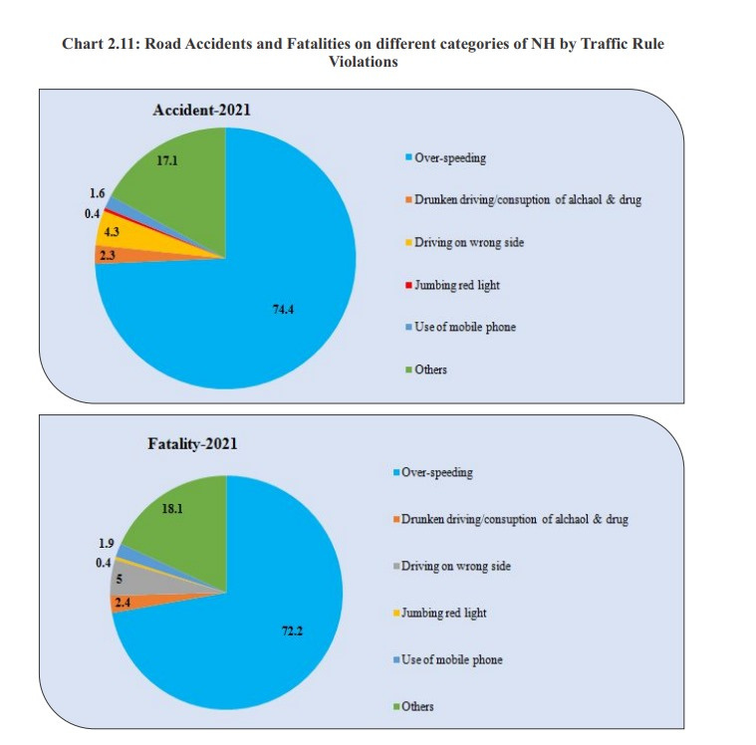
Major causes of accidents:
Over-Speeding
Drunk driving
Distracted driving
Reckless driving
Poor road infrastructure
Weather Conditions
Not aware of proper routes.
Lack of traffic rules.
Lack of safety rules.
Lack of maintenance of vehicles

Slide 4




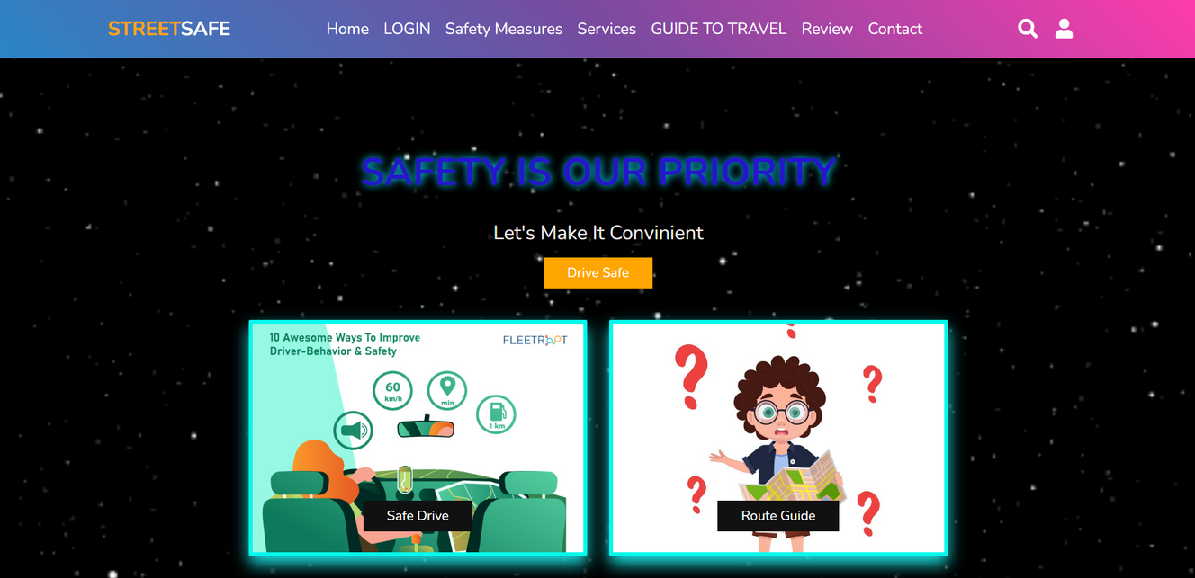
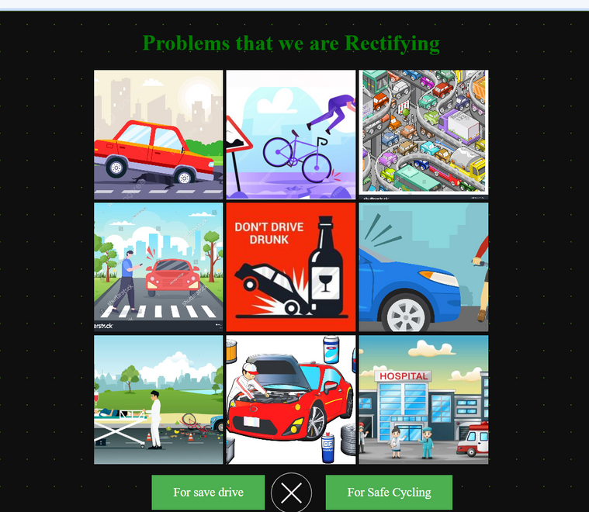

Solution:
A
AI - Chatbot feature:
Alerts the user in case of traffic, weather adversities, landslides, waterlogging, potholes, and other deteriorating road conditions.
automatically gives a better route
Provides safety guidelines on the basis of the circumstance
B
Gives a safe and economical route
C
Provides speed limits and gives an alert if the user crosses it
D
In case of a breakdown of the vehicle provide information on the closest mechanics and garages.
E
In case of an accident send a notification to the nearby hospitals, and police stations.
A notification will also be sent to the Registered users giving the location and asking for help if possible.
G
The portal also helps in detecting a save and hurdle free path for your travel journey.
H
Gives user a benefit of SOS services through which their location will be sent along with an image captured at the moment to police and their sos contacts.
I
Secures your login and user detail and makes it an end to end encrypted conversation
J
Provides you with complete accident free and more interactive ride

Slide 5







Frontend: HTML 5, CSS, JavaScript, React JS
Tech Stack
Backend: Google Map API’s, AI integration.
USED IN PROTOTYPE
Stack for future Goals: AI/ML model
Unique factors: Alerts pop up through AI chat Bot
Model utilization: Website and Mobile App

Slide 6


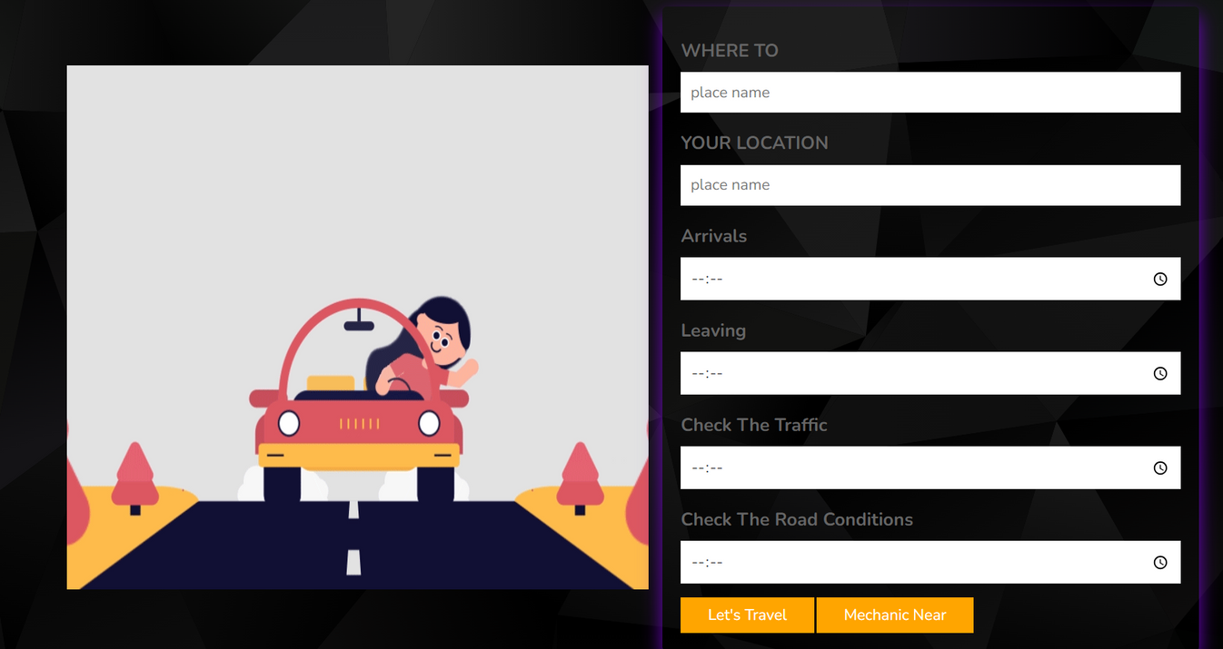

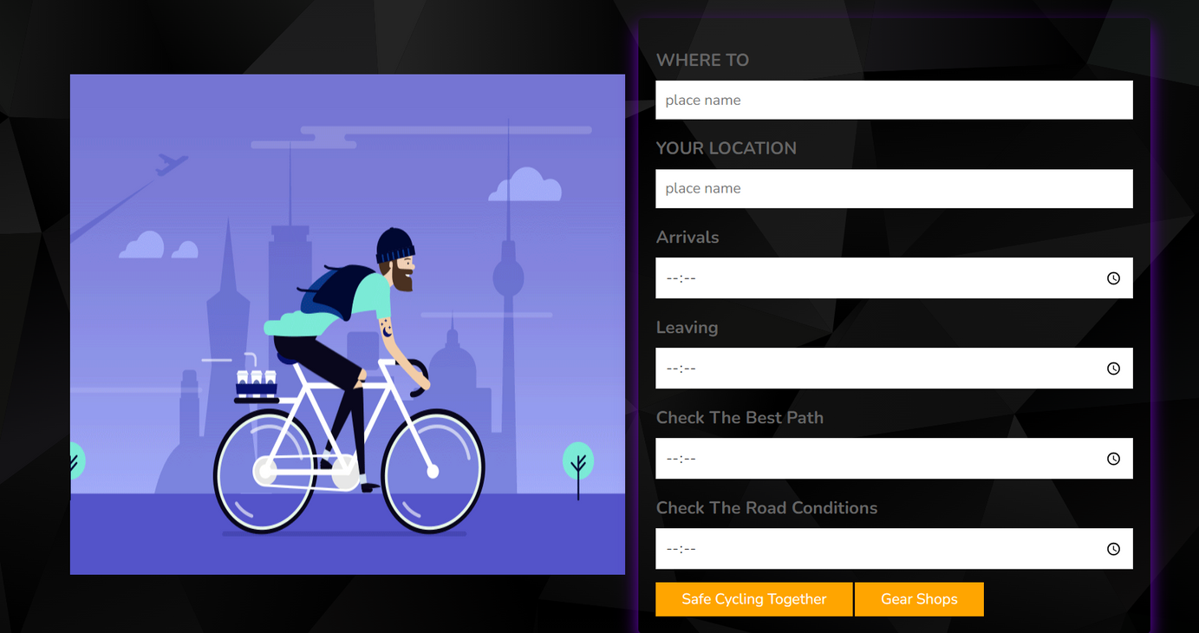


for Safe
DRIVING
we are trying to make each drive easy adding features like road health detection, weather, traffic, and most importantly availing the availability of nearby mechanics the re-routing will be done according to all these measures.
for Safe
CYCLING
we will provide you with the safest timings, suitable weather conditions, and an overview of the perspective of nearby gear shops, and essential shops.
we will even provide you with an SOS service in case of any emergency.
Through the portal, you can even connect friends and go cycle along...

Slide 7







precautions related to drink
and drive
A significant concern is the issue of individuals who engage in drunk driving. To address this problem, we have devised a unique solution: the utilization of a vehicle speed modulation detector. This system operates as follows:
Vehicle Speed Modulation Detector
Safety Notifications
Enforcement
Detection of Dangerous Movements
Persistent Speeding Alerts
As soon as the vehicle surpasses the speed limit, a notification with safety precautions will be sent to the driver. If the driver does not reduce their speed, authorities will be informed and strict action will be taken.

Slide 8


Speed limits
1. Notification on Speed Limit Violation:
- When the user exceeds the speed limit, immediately notify them.
- Clearly state the current speed limit in the notification.
- Politely ask the user to adhere to the posted speed limit.
2. Monitoring User Compliance:
- Continuously monitor the user's speed.
- If the user continues to exceed the speed limit after the initial notification, record the duration of non-compliance.
3. Final Warning:
- If the user exceeds the speed limit for a specified duration (e.g., 5 minutes), issue a final warning.
- Emphasize the importance of adhering to speed limits for safety.
4. Notifying Authorities:
- If the user does not comply with the final warning, promptly inform the relevant authorities.
- Provide them with all necessary details, including the user's location and vehicle information.

Slide 9



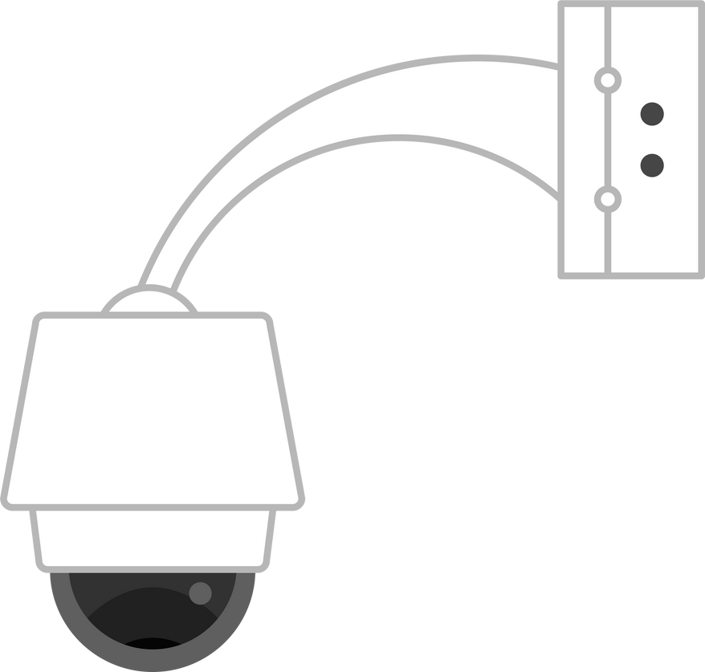




How will we collect data?
We will collect data by utilizing cameras placed on roads. This will involve collaborating with various entities, including shop owners, homeowners, traffic signals, toll booths, police checkpoints, highways, major roads, metro stations, and public places.
Additionally, we will seek volunteers to provide data from these cameras, which will aid in verification and record-keeping. In special cases, such as crimes, footage from these cameras will be used as evidence.
Building a community with people and collaborating with the security camera installers.
we will ensure every camera works properly and different type of cameras would be installed so we can capture night and day footage too.
We will also maintain end to end encryption and maintain users information confidentiality.

Slide 10
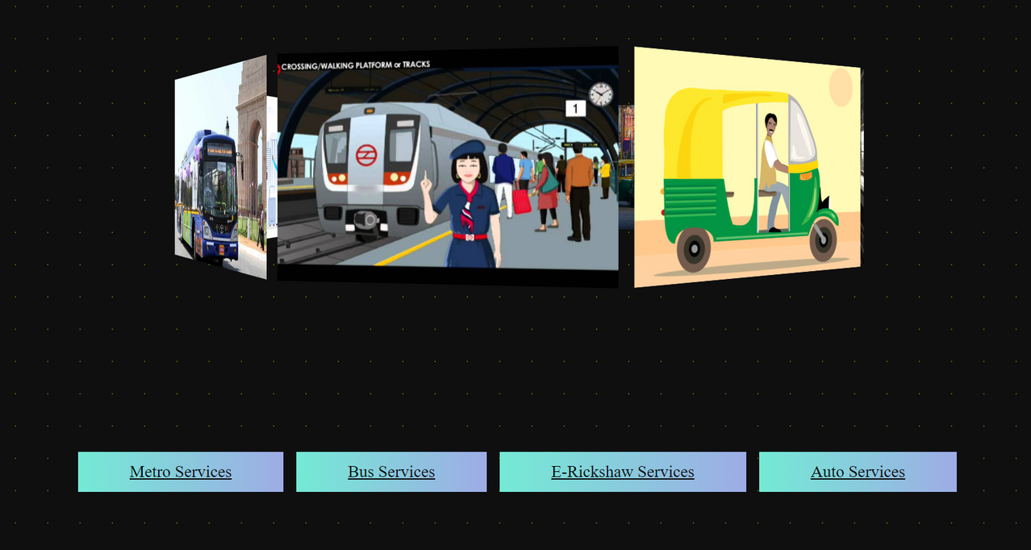
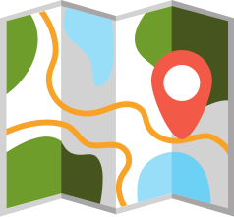
FINDING A CLEAR ROUTE MAP
Provides us with :
Short and efficient routes via metro, bus, and rickshaws:
You can enter your departure and arrival locations and get the most feasible route
booking of tickets
simplification of a complicated system
further enhances travel experience
AS STUDENTS TODAY TRAVELLING THROUGH THEIR UNIVERSITY FACE AN ISSUE THAT WHICH ROUTE IS MORE CONVENIENT FOR THEM AND SAFE AS WELL, SO BY OUR PORTAL IT WILL BECOME MORE HANDY TO TRAVEL BY ANY MEANS OF TRANSPORT YOU CHOOSE...

Slide 11






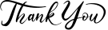
Data security and user safety
User consent: A very important aspect of the success of our project is user consent, we would take well-informed consent from the user before using their location.
Minimized data collection: only necessary data will be collected
Encrypted data: collected data will be stored securely using encryption
User’s strength: User has a complete choice to remove or edit their data whenever they want to.
Ethical data usage: data provided by the user will be used ethically and any harmful actions will be avoided.
Data usage: No usage of critical and personal data.

